Slide 1



Climate Action
NOW
Films and Toolkit to Raise the Priority of the Climate Crisis and Inspire Action

Slide 2
RCAN GOALS
Reinforce the URGENCY of the climate crisis
Raise the PRIORITY of taking climate action
Provide TOOLS to take action

Slide 3
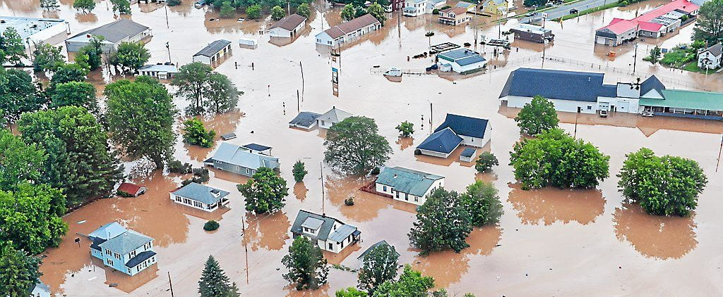
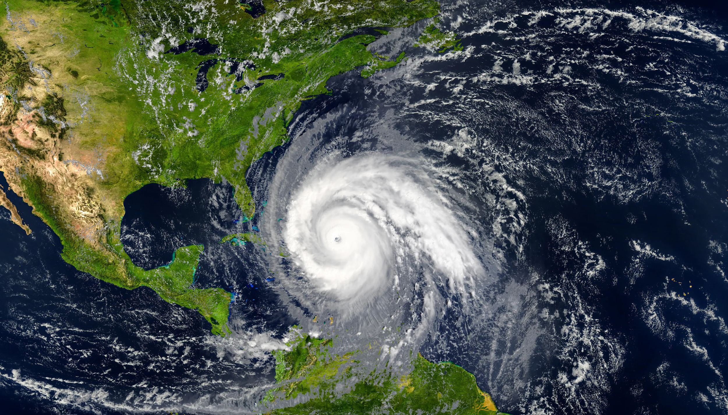
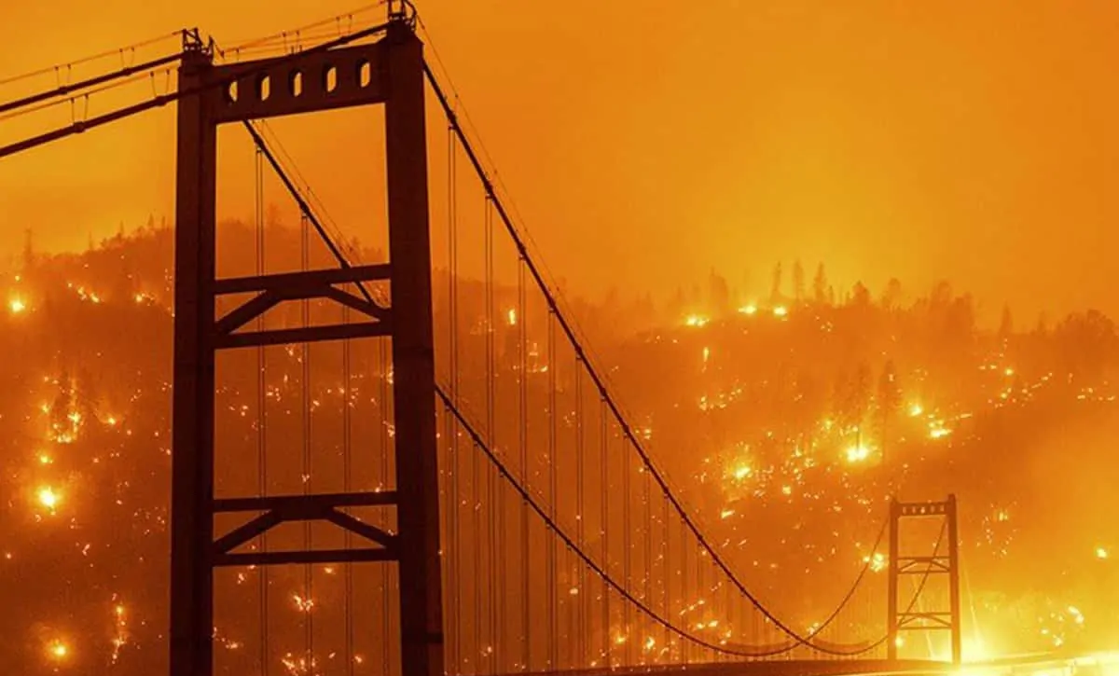
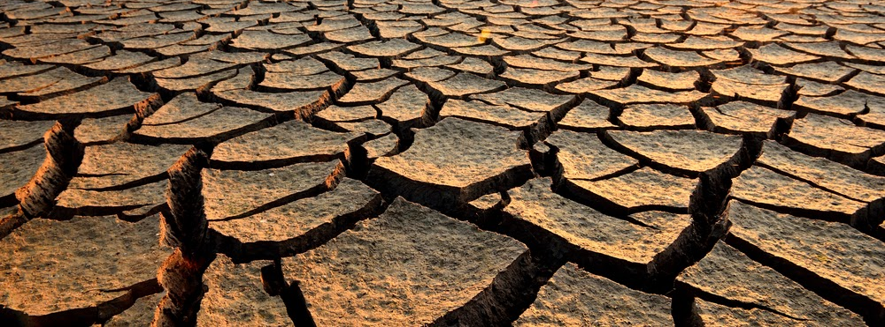

Slide 4
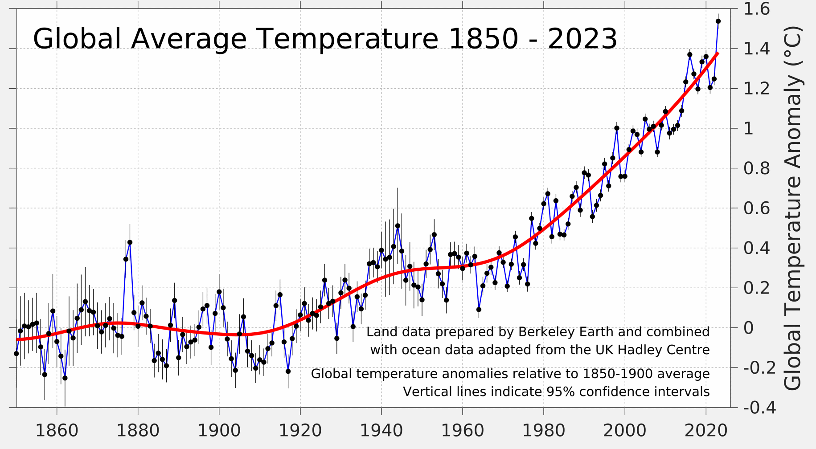

Slide 5
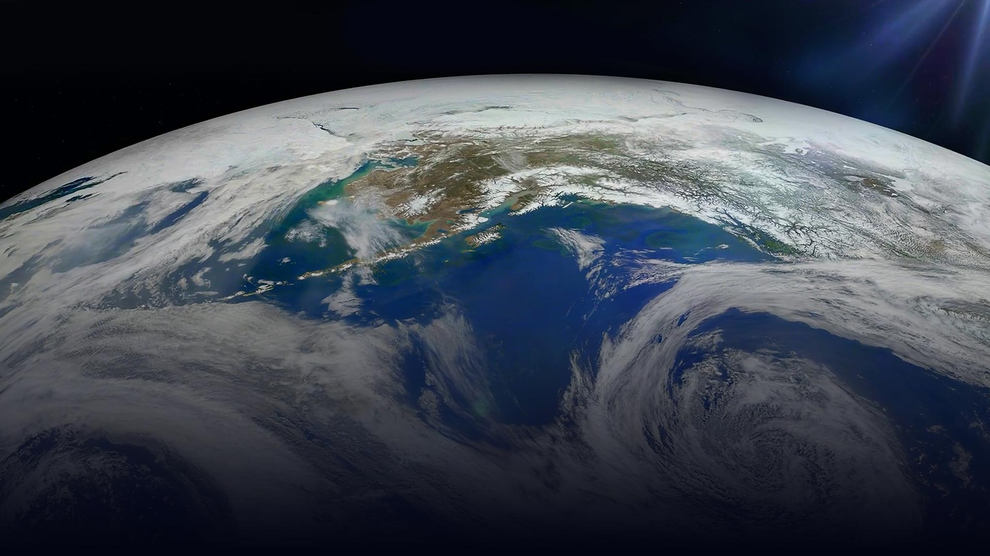
Climate
Feedback
Loops

Slide 6
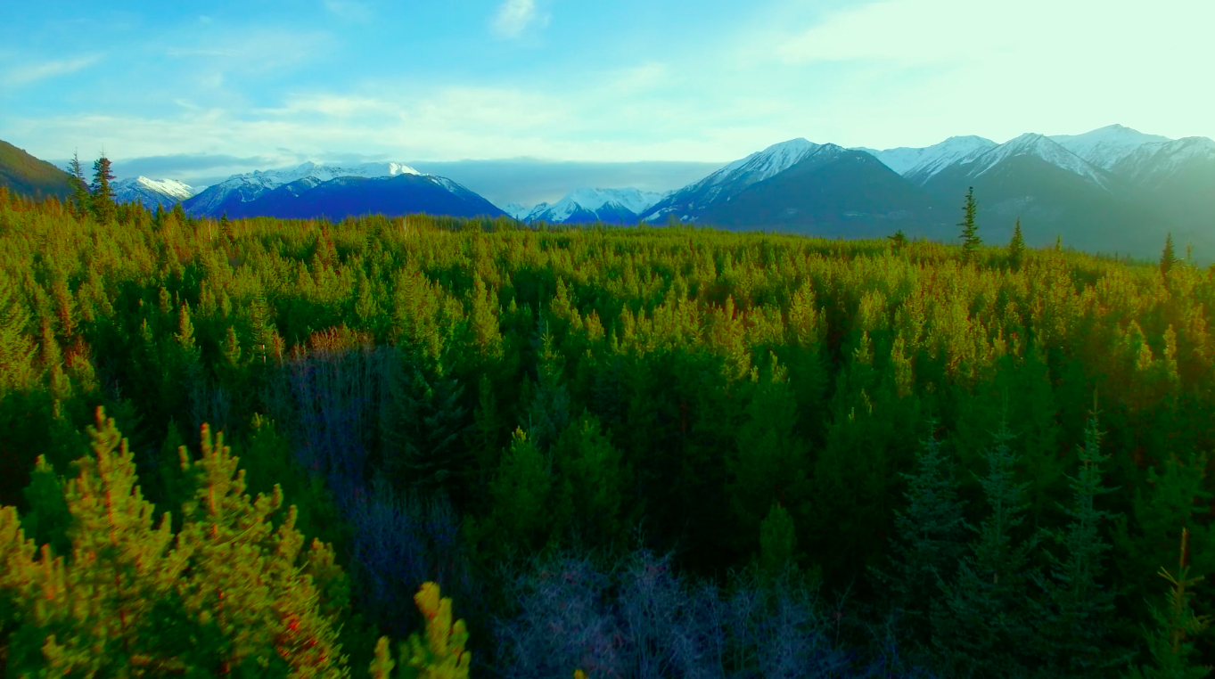
Climate Emergency: Feedback Loops
Forests

Slide 7
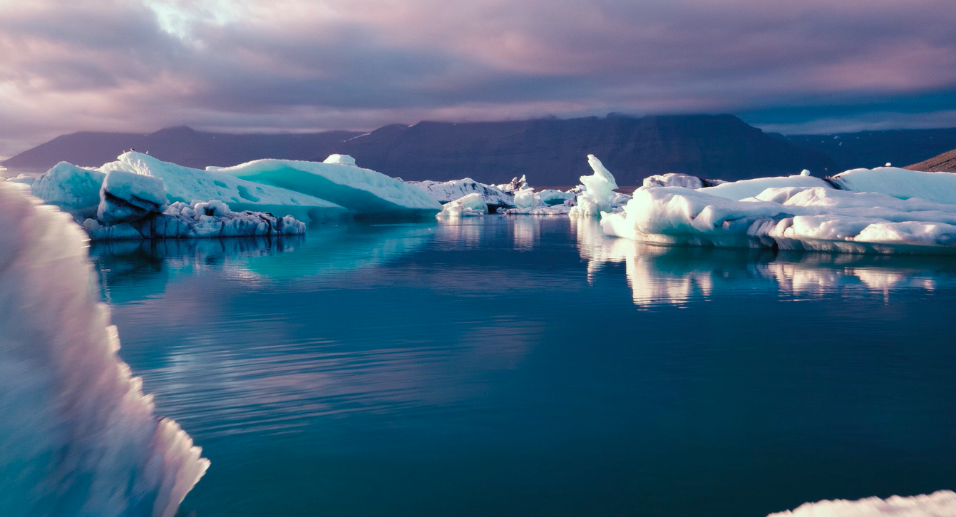
Climate Emergency: Feedback Loops
Forests
Albedo

Slide 8
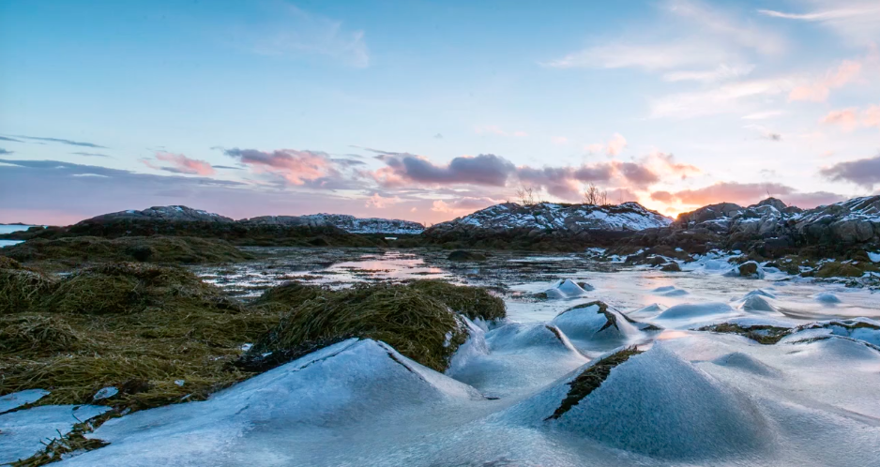
Climate Emergency: Feedback Loops
Forests
Albedo
Permafrost

Slide 9
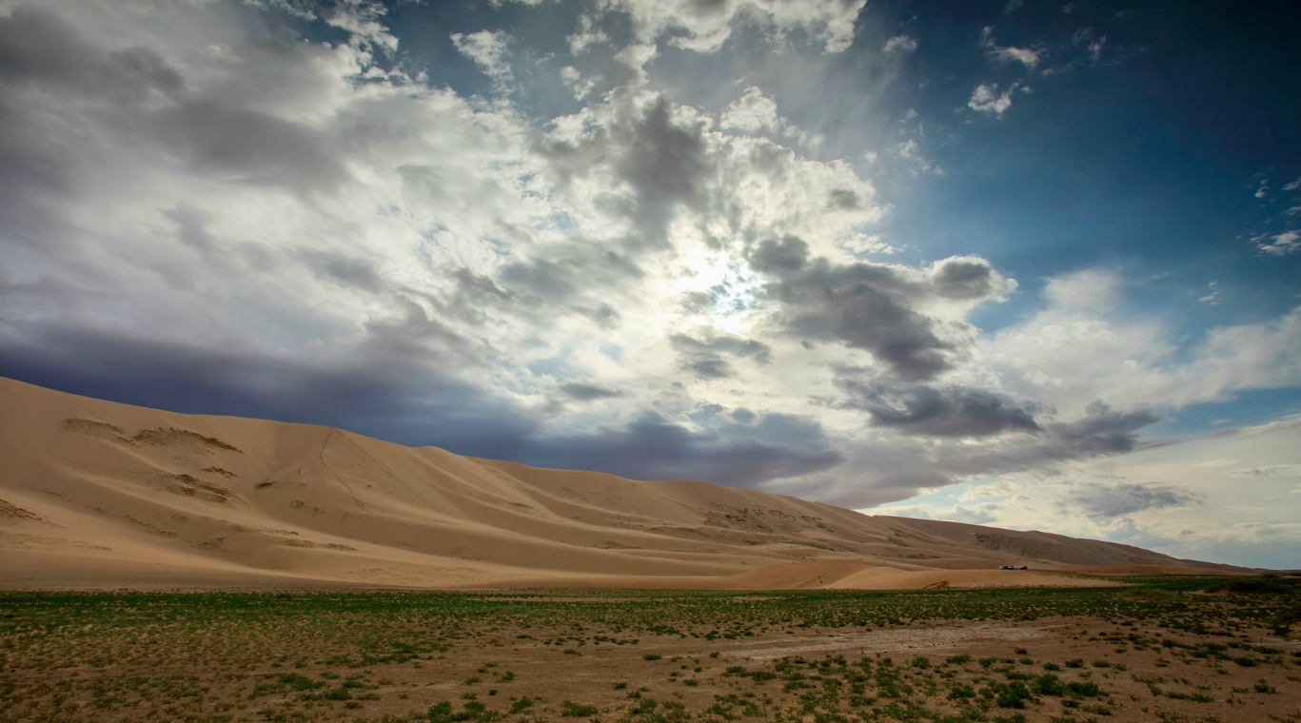
Climate Emergency: Feedback Loops
Forests
Atmosphere
Albedo
Permafrost

Slide 10
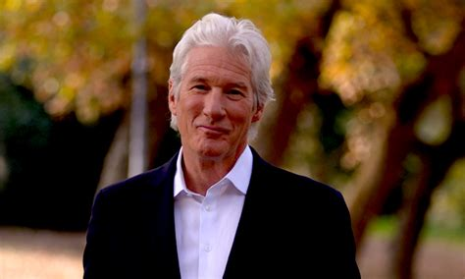
Climate Emergency: Feedback Loops
Forests
Atmosphere
Introduction
Albedo
Permafrost

Slide 11

Many people see these films and have feelings of fear, sadness, or that it’s too late to stop feedback loops and/or the climate crisis.
IT IS NOT TOO LATE

Slide 12


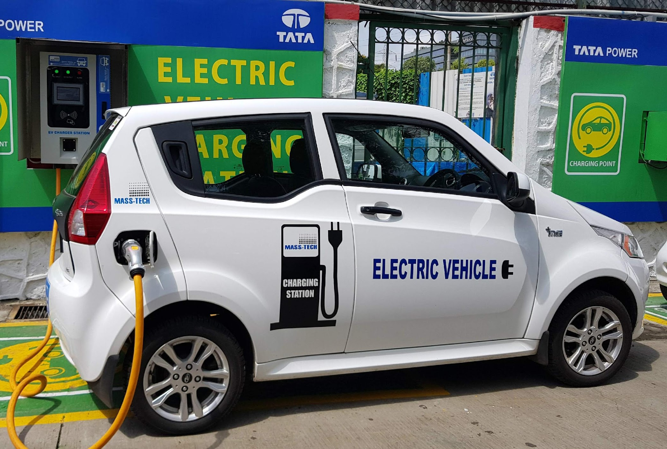


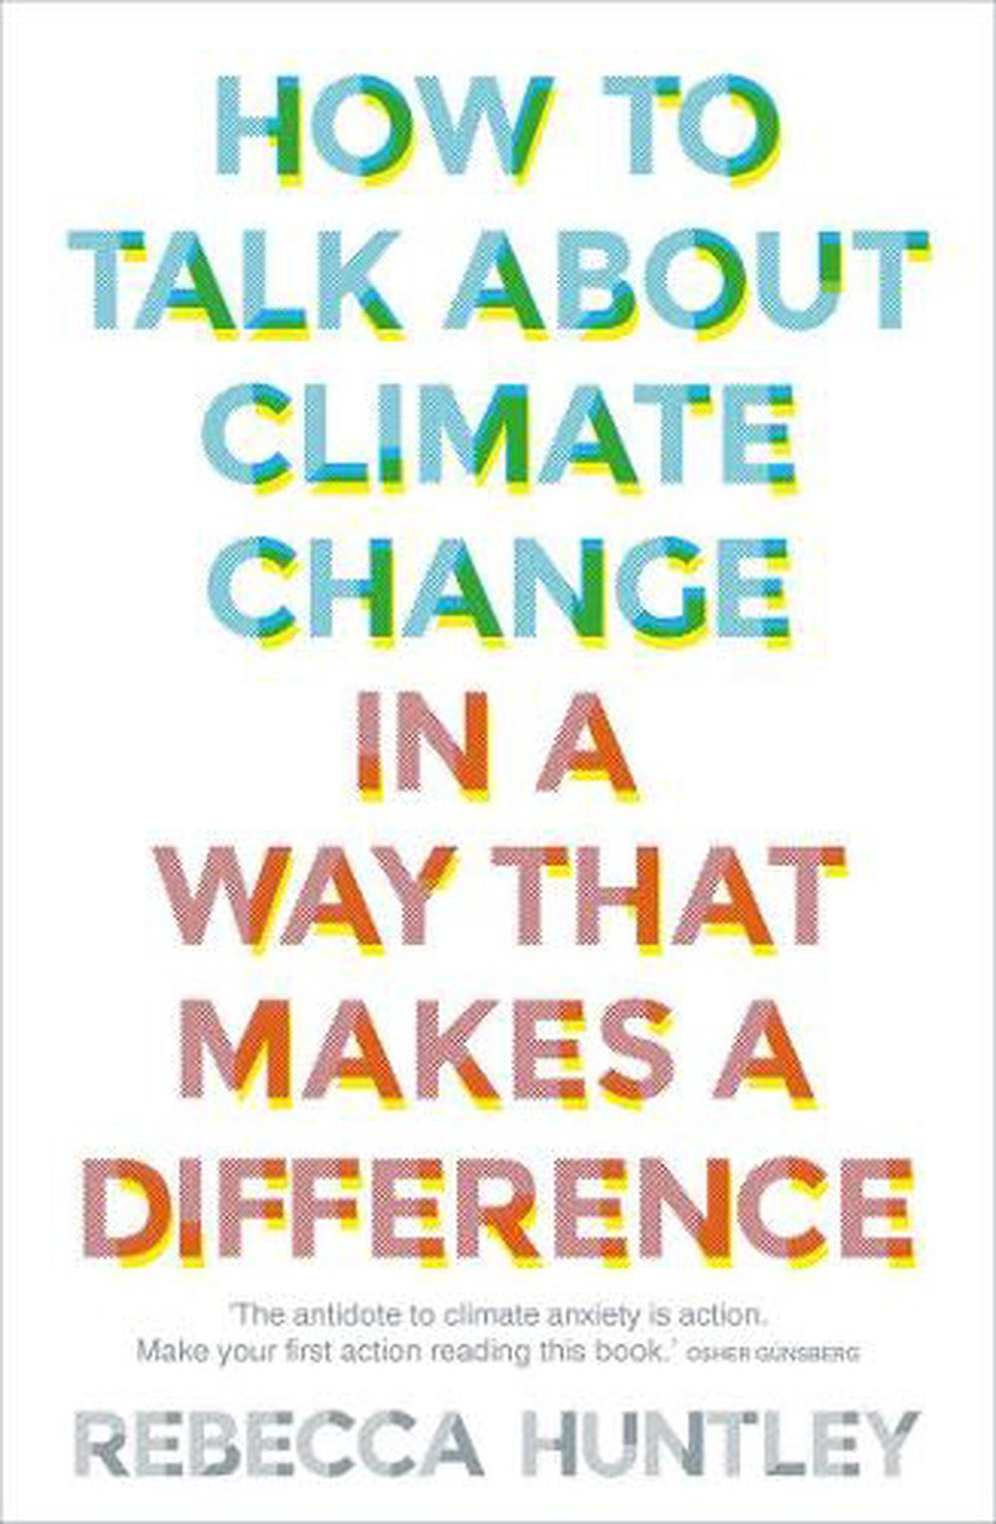

What Can YOU DO?
Individual Action
is good…

Slide 13

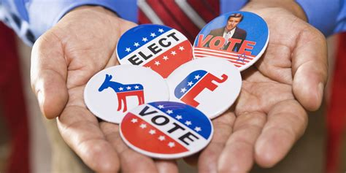

What Can You DO?
Group Action
Turns the Tide

Slide 14
What Can You DO?
Group Action
Turns the Tide
Present an RCAN Film Event in Your Community

Slide 15
A group of environmental & human rights organizations and 1,700 Dutch citizens filed a lawsuit and a court ordered Shell to cut its carbon emissions by 45% by the year 2030. It's believed to be the first against a multinational corporation.
16 young people in Montana sued the state due to its support of fossil fuels. On August 30, 2023 a judge ruled in their favor because their Constitution guarantees a “right to a clean and healthful environment”. This is the first case of its kind in the US.
California largely avoided blackouts in 2023 because of wind, solar, and batteries. Last year about 28 percent of the state’s energy came from renewable sources. Now that figure is almost 45 percent.
Renewable energy was also key to helping power Texas through the brutally hot summer for 2023.
The permit to continue construction extension to the Keystone oil pipeline was revoked due to the work of Indigenous & environmental activists. It's proof that the activism of individuals really does make a difference.

Slide 16
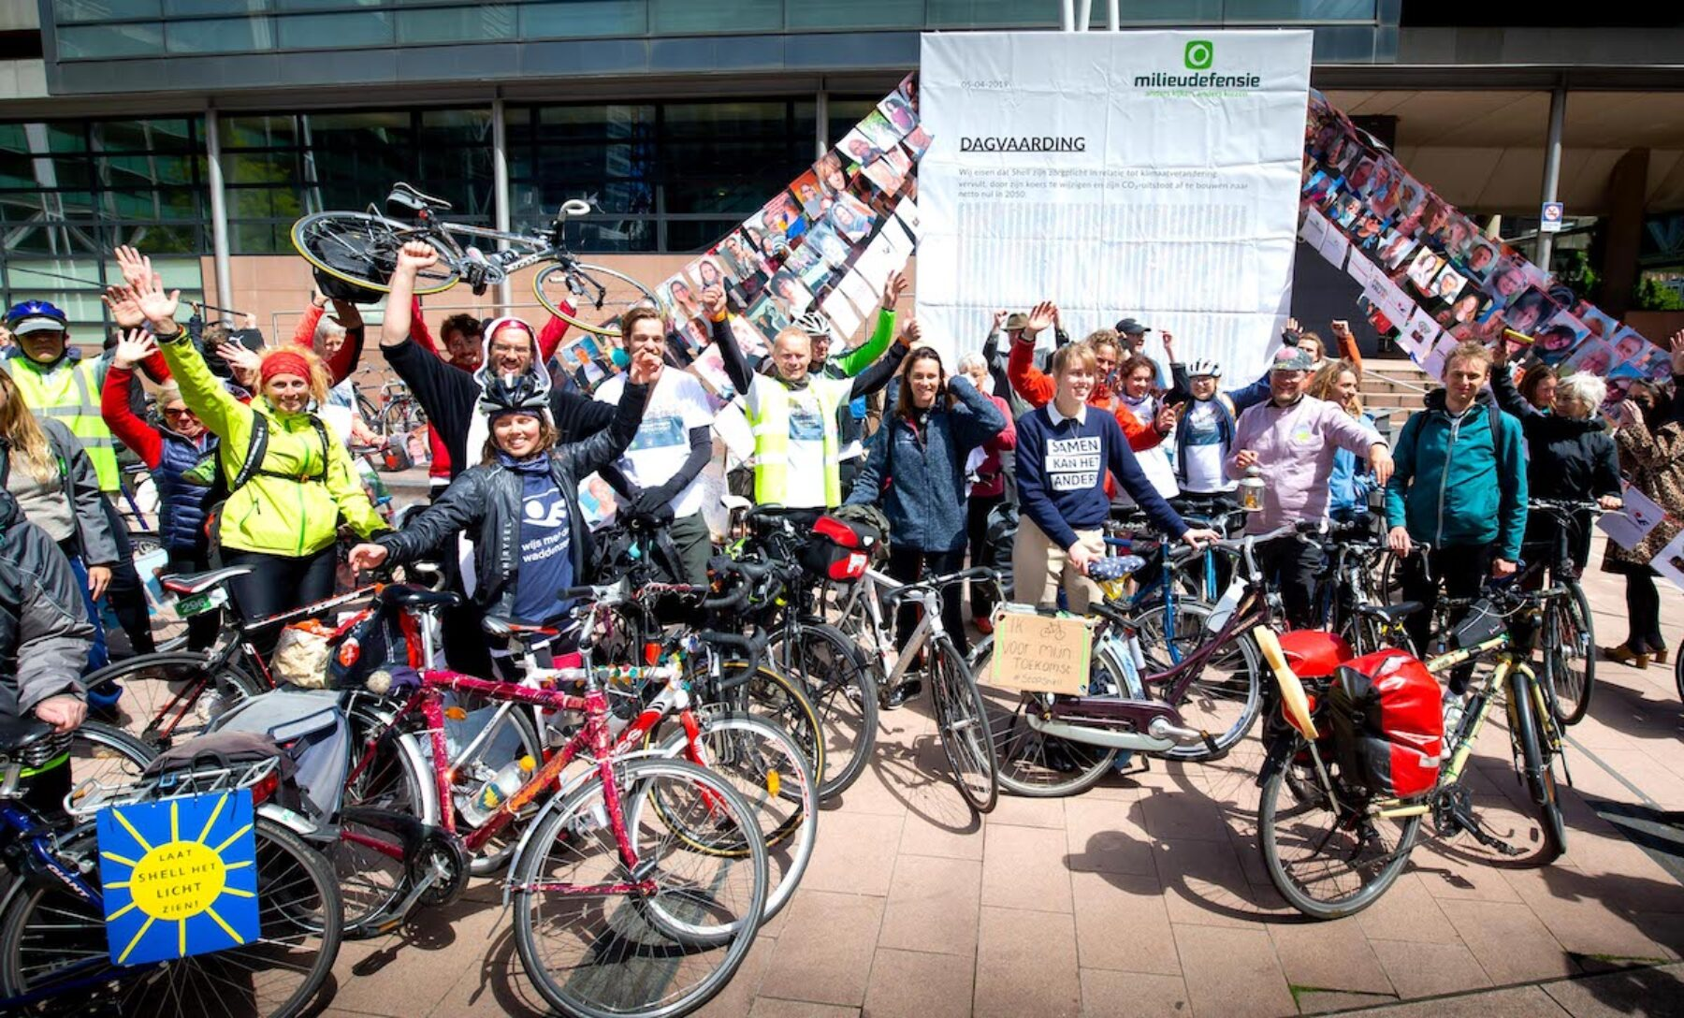
A group of environmental & human rights organizations and 1,700 Dutch citizens filed a lawsuit and a court ordered Shell to cut its carbon emissions by 45% by the year 2030. It's believed to be the first against a multinational corporation.
16 young people in Montana sued the state due to its support of fossil fuels. On August 30, 2023 a judge ruled in their favor because their Constitution guarantees a “right to a clean and healthful environment”. This is the first case of its kind in the US.
California largely avoided blackouts in 2023 because of wind, solar, and batteries. Last year about 28 percent of the state’s energy came from renewable sources. Now that figure is almost 45 percent.
Renewable energy was also key to helping power Texas through the brutally hot summer for 2023.
The permit to continue construction extension to the Keystone oil pipeline was revoked due to the work of Indigenous & environmental activists. It's proof that the activism of individuals really does make a difference.

Slide 17
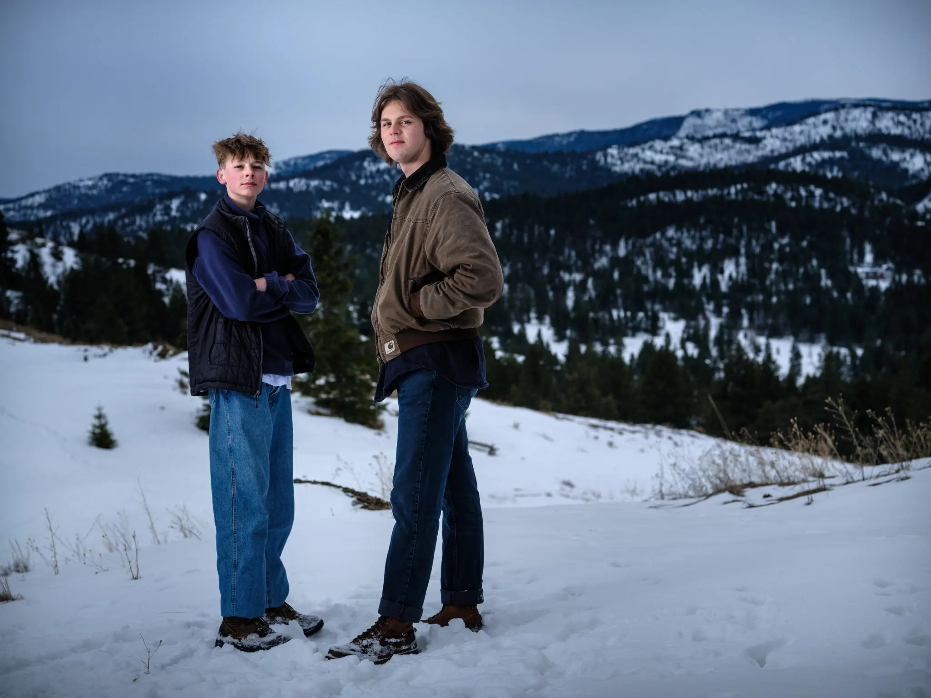
A group of environmental & human rights organizations and 1,700 Dutch citizens filed a lawsuit and a court ordered Shell to cut its carbon emissions by 45% by the year 2030. It's believed to be the first against a multinational corporation.
16 young people in Montana sued the state due to its support of fossil fuels. On August 30, 2023 a judge ruled in their favor because their Constitution guarantees a “right to a clean and healthful environment”. This is the first case of its kind in the US.
California largely avoided blackouts in 2023 because of wind, solar, and batteries. Last year about 28 percent of the state’s energy came from renewable sources. Now that figure is almost 45 percent.
Renewable energy was also key to helping power Texas through the brutally hot summer for 2023.
The permit to continue construction extension to the Keystone oil pipeline was revoked due to the work of Indigenous & environmental activists. It's proof that the activism of individuals really does make a difference.

Slide 18

A group of environmental & human rights organizations and 1,700 Dutch citizens filed a lawsuit and a court ordered Shell to cut its carbon emissions by 45% by the year 2030. It's believed to be the first against a multinational corporation.
16 young people in Montana sued the state due to its support of fossil fuels. On August 30, 2023 a judge ruled in their favor because their Constitution guarantees a “right to a clean and healthful environment”. This is the first case of its kind in the US.
California largely avoided blackouts in 2023 because of wind, solar, and batteries. Last year about 28 percent of the state’s energy came from renewable sources. Now that figure is almost 45 percent.
Renewable energy was also key to helping power Texas through the brutally hot summer for 2023.
The permit to continue construction extension to the Keystone oil pipeline was revoked due to the work of Indigenous & environmental activists. It's proof that the activism of individuals really does make a difference.

Slide 19
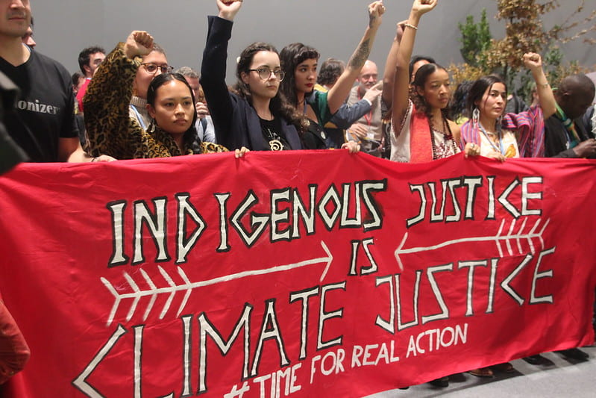
A group of environmental & human rights organizations and 1,700 Dutch citizens filed a lawsuit and a court ordered Shell to cut its carbon emissions by 45% by the year 2030. It's believed to be the first against a multinational corporation.
16 young people in Montana sued the state due to its support of fossil fuels. On August 30, 2023 a judge ruled in their favor because their Constitution guarantees a “right to a clean and healthful environment”. This is the first case of its kind in the US.
California largely avoided blackouts in 2023 because of wind, solar, and batteries. Last year about 28 percent of the state’s energy came from renewable sources. Now that figure is almost 45 percent.
Renewable energy was also key to helping power Texas through the brutally hot summer for 2023.
The permit to continue construction extension to the Keystone oil pipeline was revoked due to the work of Indigenous & environmental activists. It's proof that the activism of individuals really does make a difference.

Slide 20

A group of environmental & human rights organizations and 1,700 Dutch citizens filed a lawsuit and a court ordered Shell to cut its carbon emissions by 45% by the year 2030. It's believed to be the first against a multinational corporation.
16 young people in Montana sued the state due to its support of fossil fuels. On August 30, 2023 a judge ruled in their favor because their Constitution guarantees a “right to a clean and healthful environment”. This is the first case of its kind in the US.
California largely avoided blackouts in 2023 because of wind, solar, and batteries. Last year about 28 percent of the state’s energy came from renewable sources. Now that figure is almost 45 percent.
Renewable energy was also key to helping power Texas through the brutally hot summer for 2023.
The permit to continue construction extension to the Keystone oil pipeline was revoked due to the work of Indigenous & environmental activists. It's proof that the activism of individuals really does make a difference.

Slide 21
How To Get Started

Slide 22
How To Get Started
The
Toolkit

Slide 23
The RCAN Toolkit
Government Officials
Find YOUR local, state & Federal Representatives
Environmental Organizations
General, Cause-Based, Faith Based, and Solutions-Based
RCAN Film Event
Resources
Links to:
The Films
These Slides
PR Materials
Event Logistics Info
Under Construction
More to Come!
Podcasts & Ted Talks Positive messages and information about the crisis
More Films
That present more information on the climate crisis
Project Resources
For groups and individuals
Climate Success Stories
What Has Worked
Katherine Hayhoe
A thought leader in the fight to save human life on the planet.
Books & Articles
To enhance your understanding and gain a wider perspective

Slide 24
Climate Feedback Loops Take-Aways
There’s Still Time to Make a Difference
GROUP ACTION Really Moves the Needle
VOTING Is The Most Important Thing
Our Ask: Do a Community RCAN FILM EVENT

Slide 25
NOW WHAT?
Will you consider hosting a Community RCAN FILM EVENT?
Are there local organizations you could partner with for the event? Schools, “green” groups, library, Lions, etc.
How would the club benefit from hosting this?

Slide 26
RCAN GOALS
Reinforce the URGENCY of the climate crisis
Raise the PRIORITY of taking climate action
Provide TOOLS to take action

Slide 27

The RCAN Project Team
The RCAN Project Team is in Rotary District 7910 in Central Massachusetts and consists of Rotarians, Community Members, and Creators and Staff of the Climate Feedback Films.
The team is committed to supporting Rotary Clubs who want to produce an RCAN Film Community Event.
Please contact us via email at RotaryClimateToolkit@Rotary7910.org.
We would love to hear your comments or suggestions. We are especially interested in suggestions on how we might improve the RCAN Film Event or Toolkit.

Slide 28
THANK YOU from
The RCAN Project Team

